Slide 1

GitHub for Newbies
Mike Nelson
Technical Evangelist
Pure Storage
Level: Beginner

Slide 2
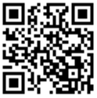
Session Survey
Your feedback is very important to us
Please take a moment to complete the session survey found in the mobile app
Use the QR code or search for “Converge360 Events” in your app store
Find this session on the Agenda tab
Click “Session Evaluation”
Thank you!

Slide 3
Topics
Git & GitHub & Gists
Why use it?
Features you will use
Step-by-Step Demos

Slide 4


Git & GitHub
Git is a SCM or VCS (RCS)
Git is crazy fast.
Git has no native UI.
Git is multi-platform.
Git is Open Source.
GitHub is free*.
GitHub is a UI for Git.
GitHub is a UI for sharing, collaborating, and storing code.
GitHub is a UI for features like CoPilot, CodeSpaces, Actions, etc.
GitHub has a Marketplace.

Slide 5


Slide 6

What is a GitHub Gist?
Gists are a simple way to share code and pastes with others without all the overhead.

Slide 7









Why use GitHub?
LEARN
SHARE
INNOVATE
COLLABORATE
ORGANIZE
HELP
BETTER CODE
CREATE CONVERSATIONS
PRESENT

Slide 8
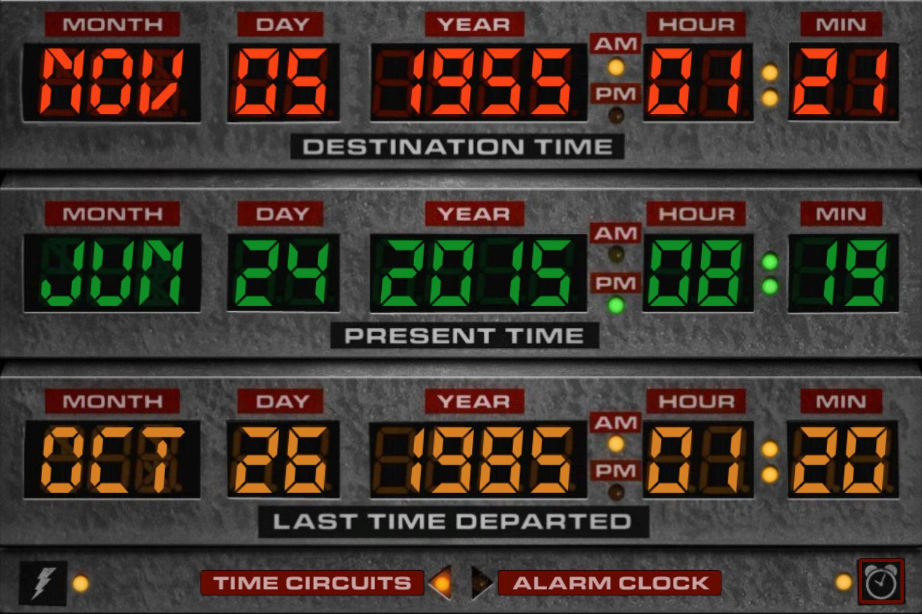
Version (Revision) Control

Slide 9
Features to use
Markdown
Repositories
Issues
Pull Requests
Commits
Branches
*Releases, CodeSpaces, Actions, Pages, Secrets, Projects, Wikis, etc.

Slide 10
Step-by-Step Demos
Creating an account
Create a repository
Check out the repo settings
Adding code to the repo
Perform a commit
Forking & cloning a repo
Changing the code & opening a Pull Request (PR)
Review & commit a PR
Perform a merge
Archive a repo

Slide 11


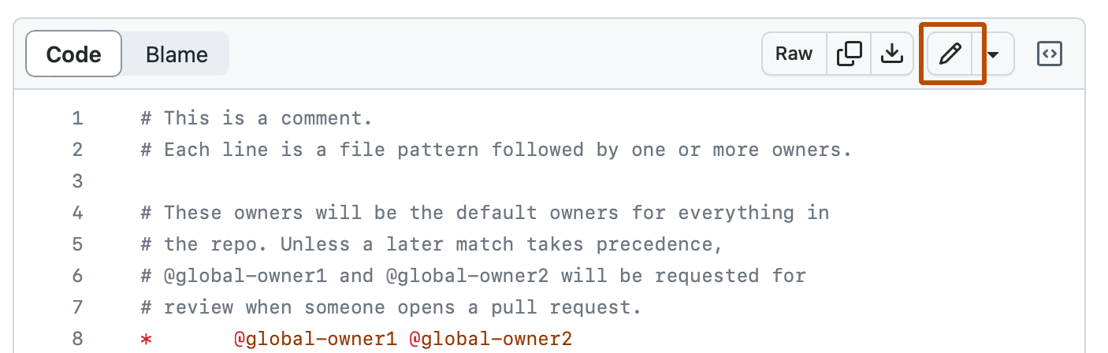


Many ways to skin a cat
Notepad++
Jetbrains
BBEdit
Sublime Text
SlickEdit
VS Code Codium
MacVim
XCode

Slide 12
create account
create SSH keys
add SSH keys
create repo
add file online
commit file
fork repo
change file
create a PR
commit the PR
merge the PR
create an issue
Notes:
create account
add SSH keys
create repo
add file online
commit file
fork repo
change file
create a PR
commit the PR
merge the PR

Slide 13
Session Survey
Your feedback is very important to us
Please take a moment to complete the session survey found in the mobile app
Use the QR code or search for “Converge360 Events” in your app store
Find this session on the Agenda tab
Click “Session Evaluation”
Thank you!

